Slide 1

CHOLESTATIC LIVER DISEASES
PRIMARY SCLEROSING CHOLANGITIS & PRIMARY BILIARY CHOLANGITIS
PATHOGENESIS AND MANAGEMENT

Slide 2
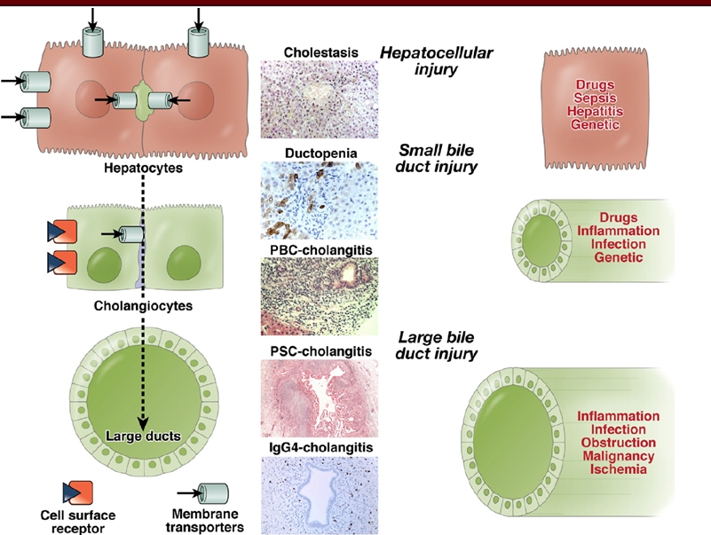
Cholestatic Liver Diseases
Introduction
PSC: Diagnosis and Clinical features
PBC: Diagnosis and Clinical Features
Pathogenesis
Management
Novel Treatment Modalities

Slide 3
Primary Sclerosing Cholangitis

Slide 4
Primary Sclerosing Cholangitis
Primary sclerosing cholangitis (PSC) is a chronic liver disease characterized by a progressive course of cholestasis with inflammation and fibrosis of the intrahepatic and extrahepatic bile ducts.
Persistent, progressive, biliary inflammation and fibrosis/stricturing/dilation.
Incidence: 0 to 1.3 cases/100,000/per year
Prevalence: 0 to 16.2 cases per 100,000 persons
60% : Male(3:2)
Median age: 41 years
Genetic and environmental risk factors.
Strong association with IBD (70 to 80%), 5% vice versa
Colon, bile-duct, and gallbladder cancers.
Molodecky NA. Hepatology 2011
Kochher et al. J Gastroenterol Hepatol. 1996

Slide 5
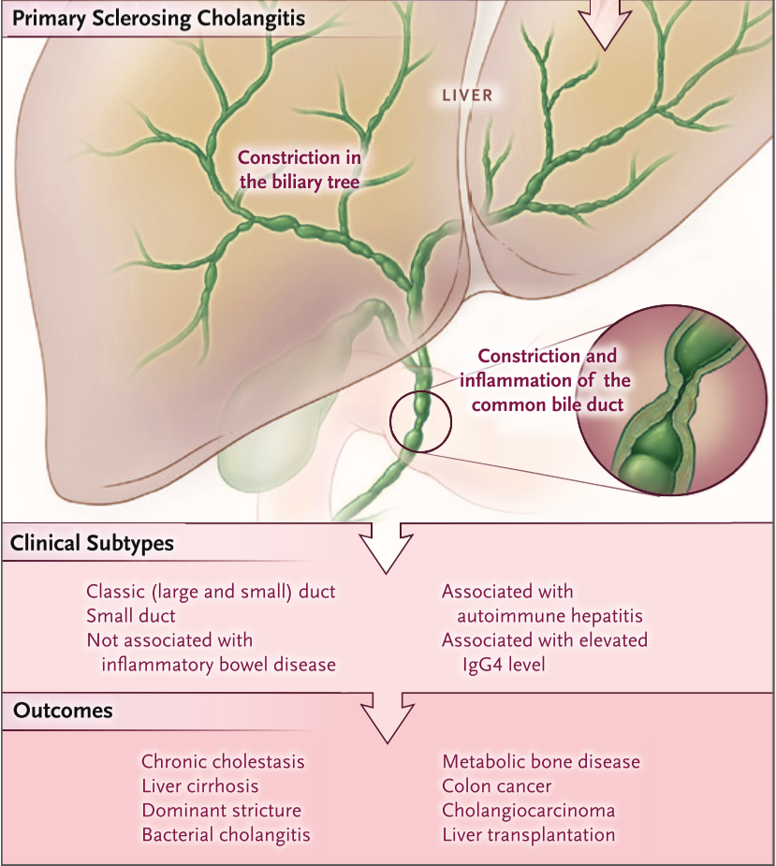
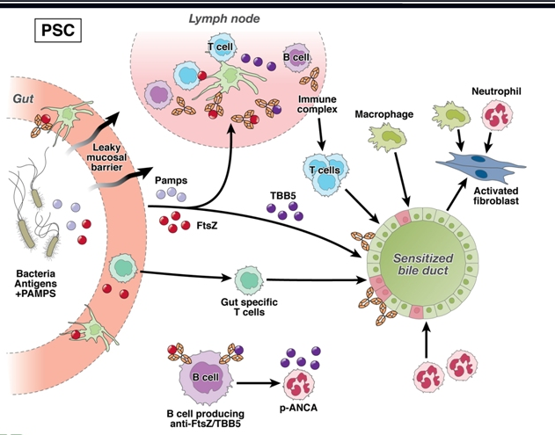

Slide 6
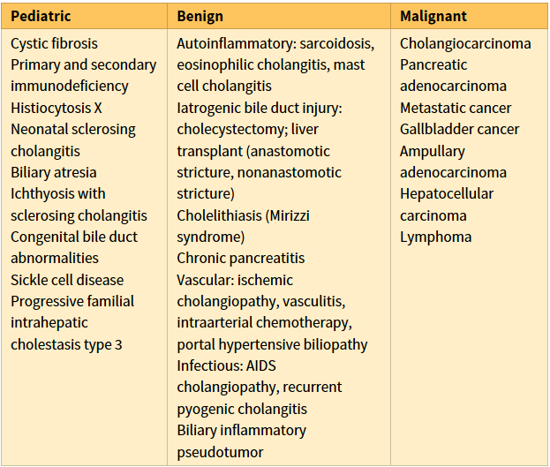
Diagnostic Approach
PSC: Diagnosis of Exclusion
Typical MRCP/ERCP features
ALP > 2x ULN for > 6 months and/or cholestatic s/s
Exclusion of secondary causes
Liver Biopsy:
Small duct PSC/ PSC-AIH overlap
Lazardis et al. NEJM 2016

Slide 7
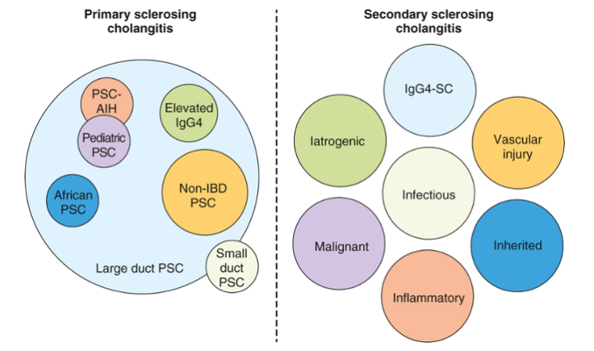
Classic PSC and variants vs. Secondary Sclerosing Cholangitis
Large duct PSC (Classic): 90%
Non IBD PSC (Older age, male=female)
Small duct PSC :5-10%
PSC-AIH Overlap: 5%-35%
IgG4- related sclerosing cholangitis
Angulo P. Hepatology 2007
Zakim and Boyers 7th Ed.

Slide 8
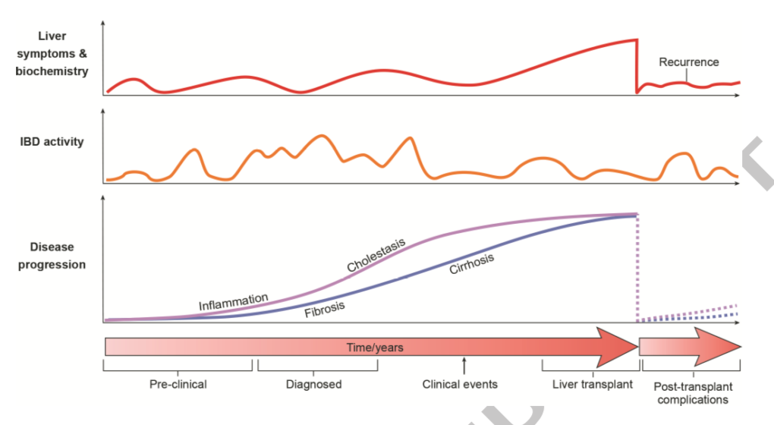
Clinical Course and Natural History
Angulo P. Hepatology 2007
Notes:
Disease course assessed by hepatic biochemistries and symptoms typically fluctuate (upper panel).
Inflammatory bowel disease (IBD) disease behavior (middle panel) is also variable and do not correlate with liver manifestations.
Liver disease progression is inevitable in the majority of patients, with fibrosis and cirrhosis due to inflammatory and cholestatic processes (Figure 2).
There is often a long preclinical phase and diagnostic lead-time however what the earliest manifestations of PSC are remains speculative.
Magnetic resonance cholangiography (MRC) has demonstrated the presence of sub-clinical PSC in patients with IBD, raising the debate as to whether MRC screening could be warranted in IBD.
Clinical events frequently warrant specialist consultation (Box 2).
Liver transplantation is the only curative treatment option, but timing varies according to local practice which involves symptomatic
indications (e.g. recurrent cholangitis, intractable pruritus) and cholangiocellular dysplasia in addition to end-stage liver disease.
Finally, as shown in the right part of the figure, a number of post-transplant issues occur in PSC, including a high frequency of acute cellular rejections, disease recurrence in more than 1/5 of the cases, and IBD exacerbations which must be demarcated from transplant related bowel complications such as cytomegalovirus colitis and mycophenolate colitis.

Slide 9
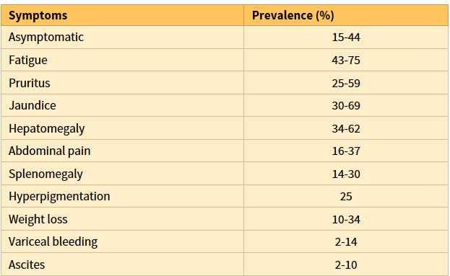
Presenting Sign and Symptoms
Eaton JE. J Gastroenterol Hepatol. 2016

Slide 10
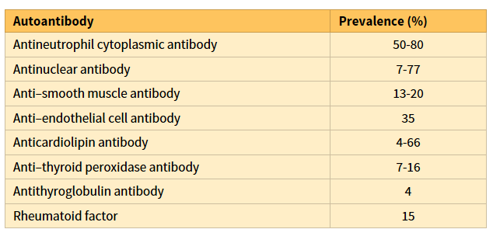
Laboratory Abnormalities
Cholestatic pattern: Raised ALP/GGT, mild to moderate transaminases
Total IgG Elevated: 60 %
IgG4 levels: elevated in 10 % patients; less than 2.8g/dl (IgG4: IgG1 < 0.24)
Autoantibodies
Eaton JE. J Gastroenterol Hepatol. 2016

Slide 11
Imaging: MRCP and ERCP: Gold Standard
Cholangiography remains the gold standard
Segmental strictures with proximal dilatation and sacculation of the bile ducts create the beaded appearance that is classic for PSC.
PSC affects both the intrahepatic and the extrahepatic bile ducts.
Isolated changes of the intrahepatic bile ducts 20% to 28% of cases.
Dominant strictures :36% to 57% throughout the disease course.
Almost 90% of PSC patients have abnormal gallbladders

Slide 12
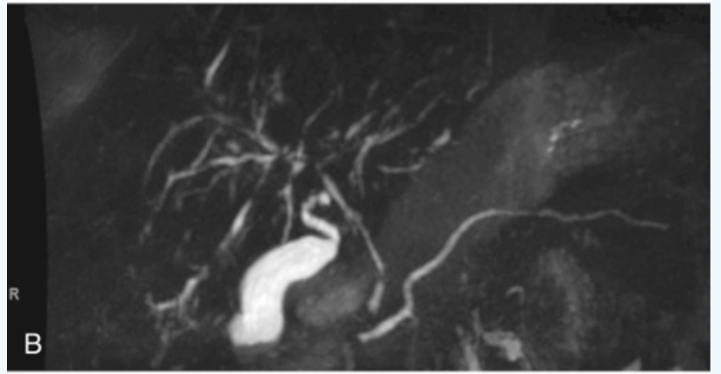
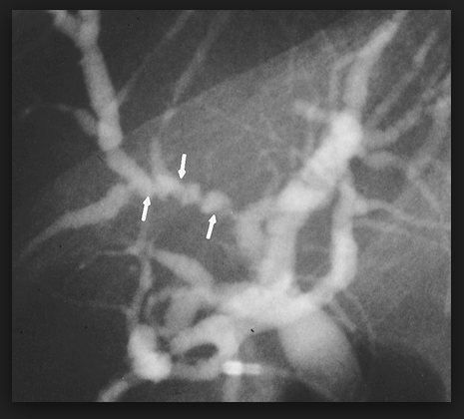

Slide 13
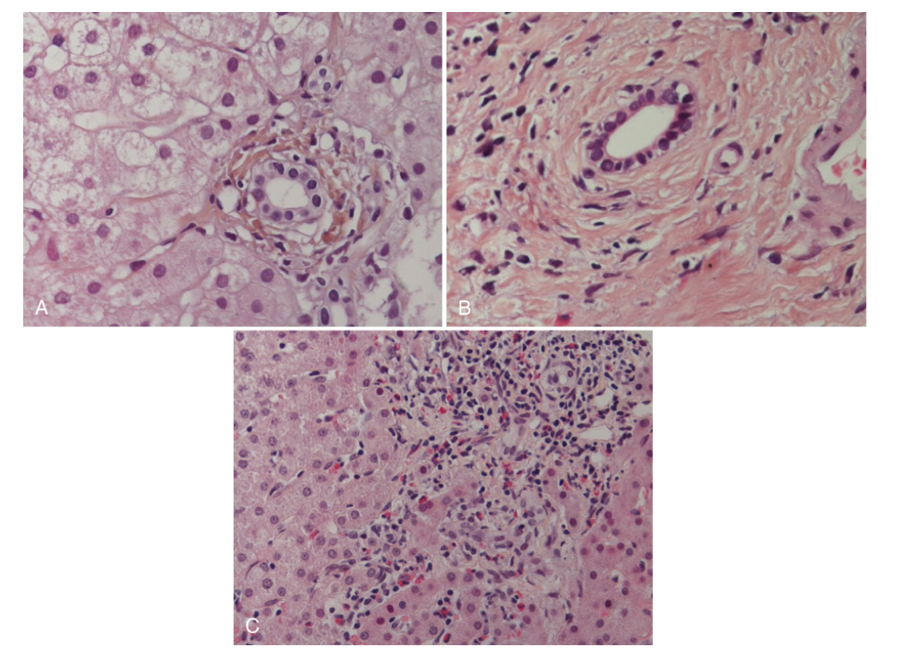
Histology
Liver biopsy: usually not needed
May be normal when only large ducts are involved.
Bile duct proliferation, periductal fibrosis with typical “onion-skin” lesions, periductal inflammation, and bile duct obliteration
Ludwig criteria

Slide 14
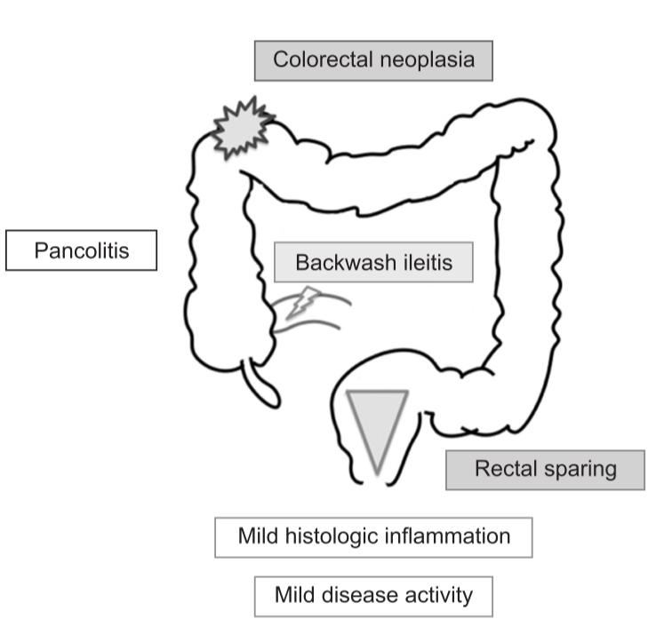
IBD in PSC
Younger age, quiescent
Mostly pre-existing IBD
70-80 % of PSC
5-10 % of IBD have PSC (Raised ALP)
May precede/ simultaneous/ after LT
Higher incidence of pouchitis
4x more prone to Colorectal neoplasia as compared to IBD alone, 10x more than gen population
Surveillance: Baseline, Yearly/ 5 yearly

Slide 15
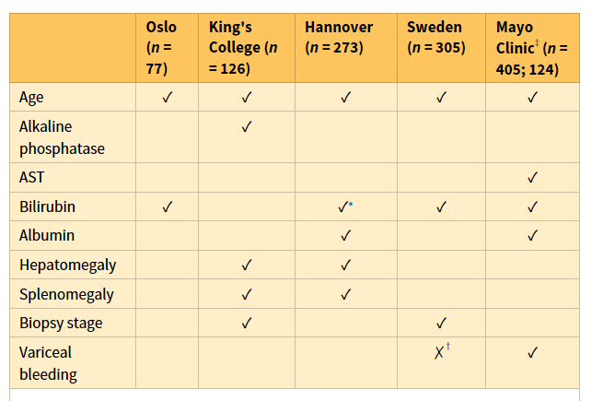
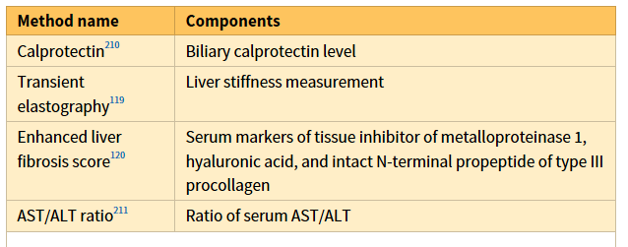
Prognostic Models predicting transplant free survival in PSC
M Vesterhus, et al. Hepatology 2015

Slide 16
Malignancies in PSC
Account for >40% of deaths.
Cholangiocarcinoma (CCA), gallbladder carcinoma (GBC) and colorectal carcinoma (CRC) variably associated (up to 13–14%)
CCA (0.5–1.5%)
Prognosis is poor (5-year survival <10%).
Younger, within 1 year of diagnosis, infiltrative type.
Surgical resection provides disappointing results; liver transplantation combined with neoadjuvant chemoradiotherapy (Mayo protocol)
CA 19-9 Cut off: >129 IU/ml (Sn 79%, Sp 99%)
Bergquist A. Scand J Gastroenterol. 2007
Levy C et al. Dig Dis Sci. 2005

Slide 17
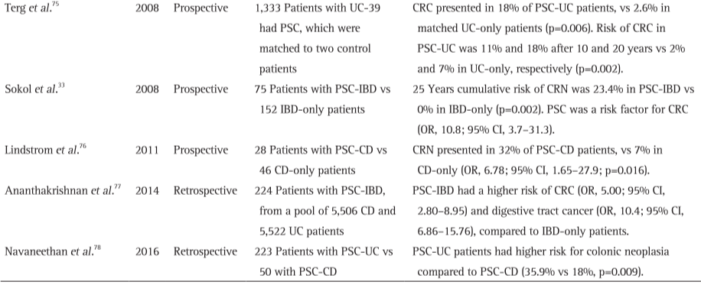
Studies Evaluating risk of Colorectal Neoplasia in PSC-IBD patients

Slide 18
Management
No proven pharmacotherapy that reduce progression/ improve mortality
Liver transplant remains the only effective modality
Primary End points: Not defined
ALP decrease to <1.5 ULN / Normal: Not validated
Current Pharmacotherapy Available:
UDCA (13-15 mg/kg)
Vancomycin (Paediatric Age group)
Novel Drugs: Phase 2 studies
Talwalkar et al. Clin Gastroenterol Hepatol. 2011

Slide 19
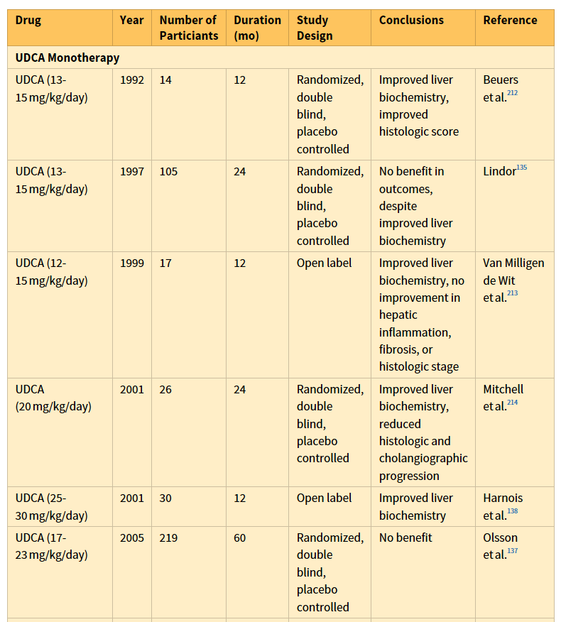
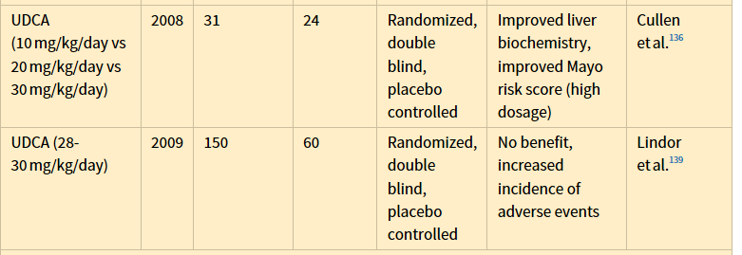
UDCA Monotherapy Trials

Slide 20
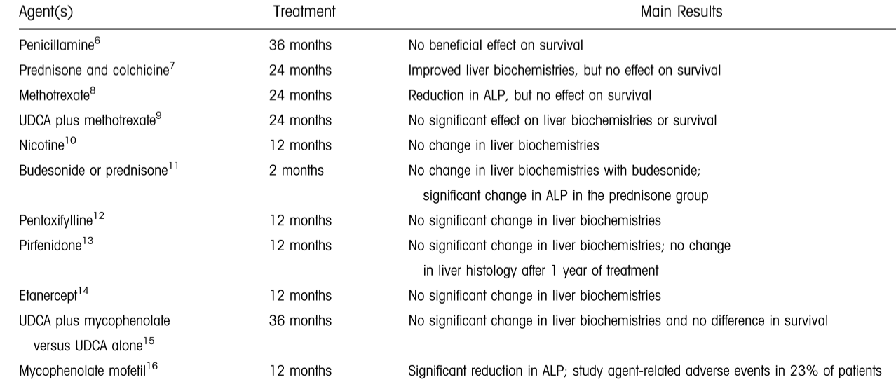
Pharmacotherapy Tried in PSC: No Benefit

Slide 21
Current Recommendations
AASLD:
In adult patients with PSC, recommend against the use of UDCA as medical therapy (1A).
EASL:
The limited data base does not yet allow a specific recommendation for the general use of UDCA in PSC.
Hepatology. 2010
J Hepatol. 2017

Slide 22
NOVEL DRUGS IN THE PIPELINE
24-Nor-ursodeoxycholic acid
C(23) homolog of UDCA,
Improved inflammation and liver function tests in a rodent model.
Phase 2 clinical trial
159 patients with PSC
Randomized to 500, 1000, and 1500 mg norursodeoxycholic acid for 12 weeks.
Treatment with nor ursodeoxycholic acid resulted in significant reduction of serum alkaline phosphatase (ALP) in all treatment groups (by 12.3%, 17.3%, and 26%, respectively).
European Association for the Study of the Liver International Liver Congress 2019, Vienna Austria

Slide 23
NOVEL DRUGS IN THE PIPELINE
Obeticholic acid: currently being evaluated in patients with PSC.
BTT1023 in PSC: Anti VAP 1, Mab
Cenicriviroc in PSC
CC2 and CCR5 antagoinist
Simtuzumab (GS-6624) in PSC
LUM001 in PSC: ASBT inhibitor
Ahmed H. Clin Liv Dis. 2016

Slide 24
Bacterial Cholangitis
6% present with cholangitis
Sudden pain, fever, chills, jaundice
Infection of the biliary ducts, often due to blockage from a stricture
Requires antibiotics with/without an ERCP to open a blockage
Sphincterotomy avoided: may increase sclerosis
Ahmed H. Clin Liv Dis. 2016

Slide 25
Liver transplant in PSC
Indications
Decompensated Cirrhosis and its complications
PSC Specific indications
Recurrent Bacterial Cholangitis
Fungal Cholangitis: even single episode
Intractable pruritus
Cholangiocarcinoma (pCCA)
1-year and 5-year survival rates of 90–97% and 80–85% respectively.
PSC a/w better post transplant survival than other etiologies
Post transplant care: CRC/IBD/Recurrence upto 30 %
Langenbecks Arch Surg 2008
Barber K Gut 2007;56:279-282.

Slide 26
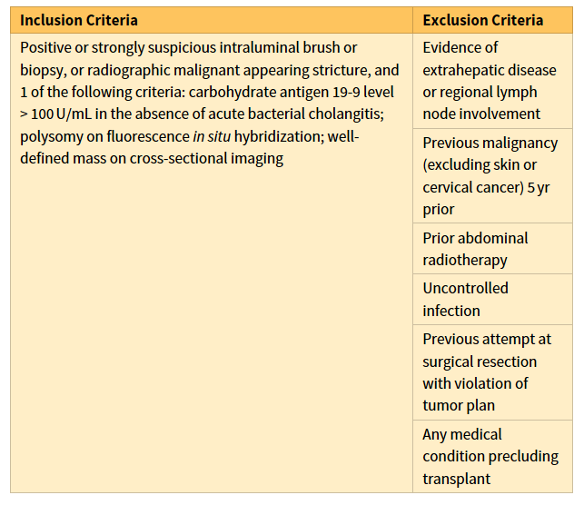
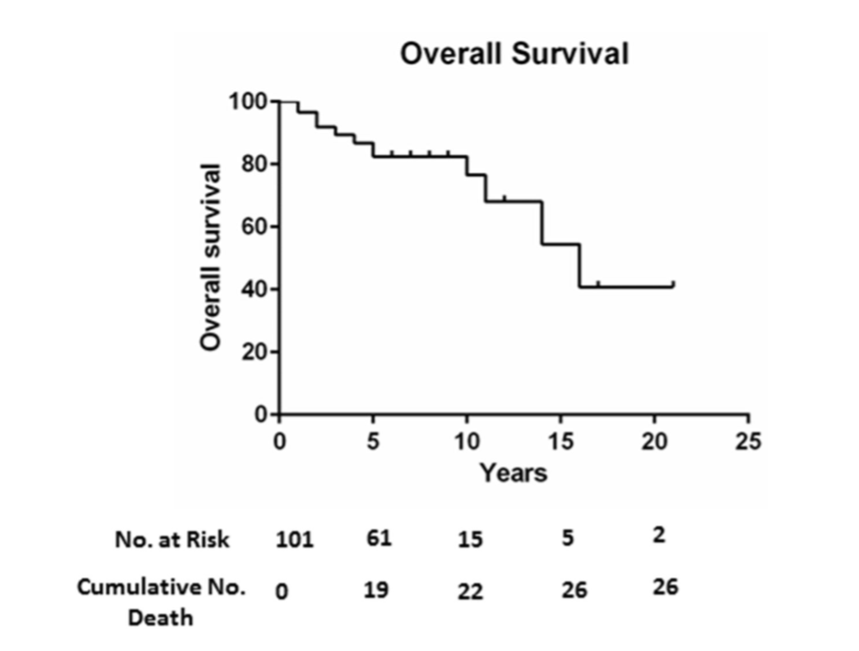
Criteria for LT in PSC with Perihilar CCA
Rizvi S et al. Gastroenterology. 2013
199 patients enrolled in the protocol
127 (64%) had underlying PSC.
62 dropped out
131 underwent transplant at the Mayo Clinic (six underwent transplant elsewhere

Slide 27
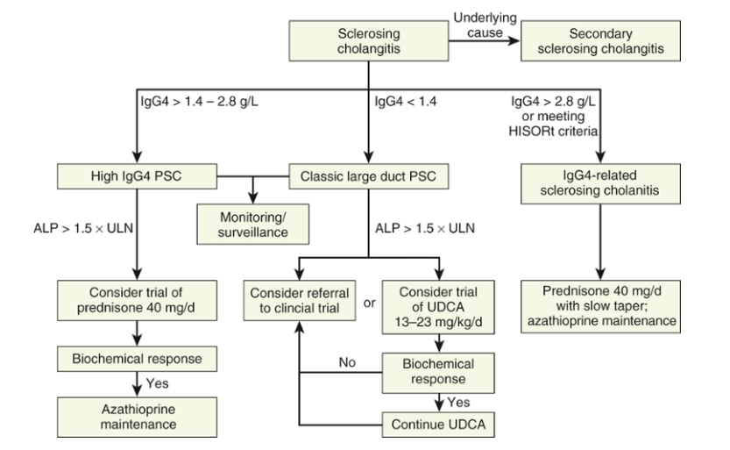
Summary of Management
Zakim and Boyer 7th Ed.

Slide 28
PRIMARY BILIARY CHOLANGITIS
Introduction
Clinical features and Markers
Pathogenesis
Risk Stratification and Management

Slide 29
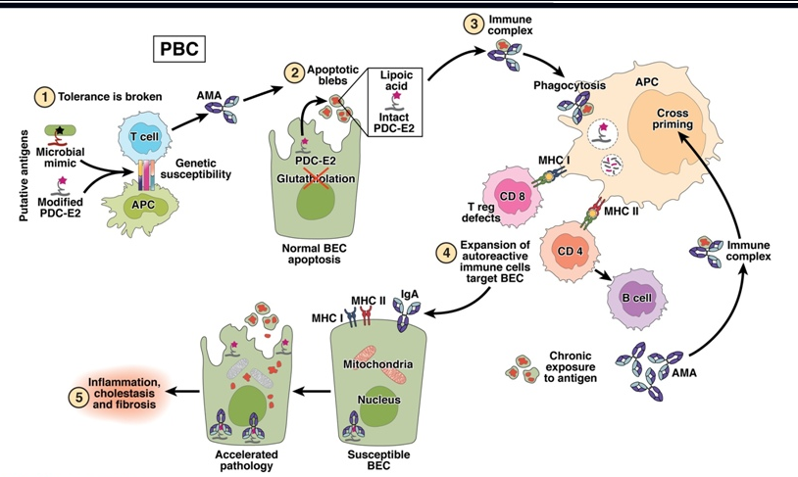
pathogenesis
Chronic progressive, autoimmune cholestatic liver disease with AMA positivity or specific ANA reactivity
Histology: Non-suppurative granulomatous small bile duct cholangitis.
Predominantly affecting middle aged females (10:1)
Pathogenesis-Complex; Environmental exposure in genetic susceptible host
Nguyen DL et al. Clin Gastroenterol 2010
Notes:
,

Slide 30
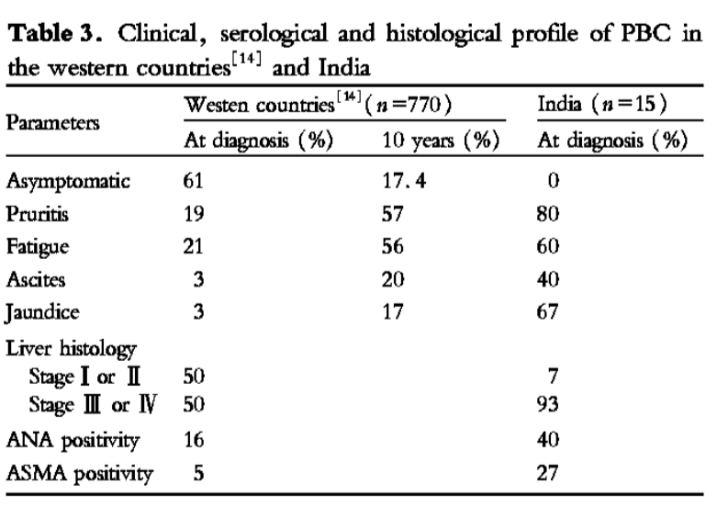
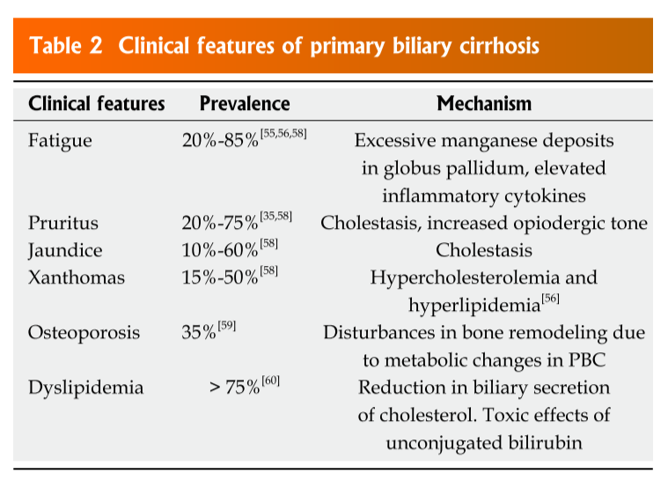
Clinical and Biochemical Features
Clinical features
Biochemical features
Immunological features
Pruritus (60-70%)
Fatigue (80 %)
Xanthoma/Xanthelasma
History of recurrent UTI and smoking
Raised ALP/GGTP
Raised IgM
AST/ALT > 1
Hypercholesterolemia
Hypoalbuminemia
Coagulopathy
Thrombocytopenia
AMA-M2 by IF titre of >1/40 (95%)
ANA by IF may be
Nuclear dot-Anti SP100
Perinuclear rim-Anti gp210
Present in 30 % of AMA +patients BUT in 2/3RD OF AMA - PBC
Sarin et al. HPB Dis. 2006

Slide 31
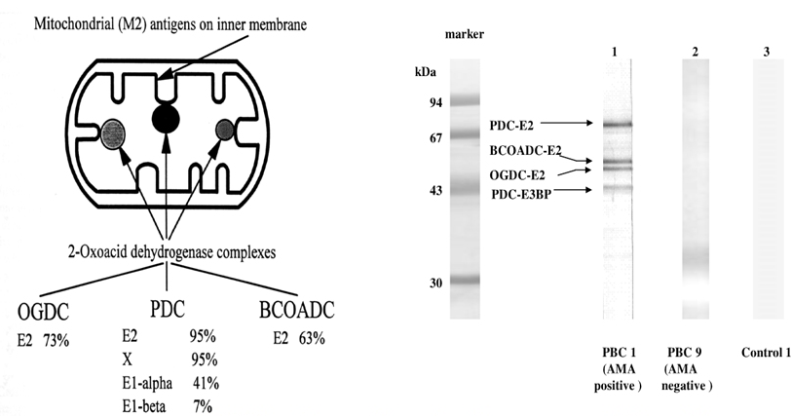
Diagnosis
Two of the following three criteria should be satisfied:
AMA titer > 1:40;
Alkaline phosphatase (AP) > 1.5 times the upper limit of normal for > 24 wk; and
Compatible liver histology, demonstrating nonsuppurative destructive cholangitis and interlobular bile duct destruction.

Slide 32
Auto antibodies in PBC
AMA
Specificity of 95% for PBC.
Non pathologic, persists after LT.
AMA Negative PBC: Similar features as that of AMA positive
Asymptomatic patients with AMA Positive: 80% of these patients will have definite PBC at 30 years
AMA-M2targets a family of mitochondrial enzymes: The 2-oxo-acid de hydrogenase complexes
PDC-E2, BCOADC-E2 and OADC-E2
Rarely, also targets PDC E1a, E1b
Swan et al Hepatology 2008

Slide 33
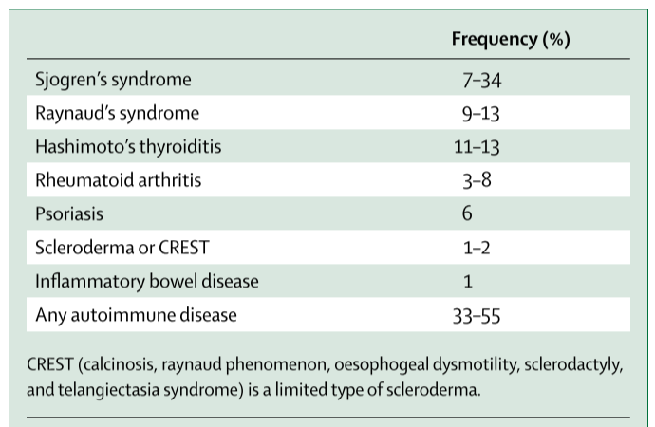
Frequency of associated Autoimmune diseases in PBC
Elizabeth J Carey et al The lancet 2011

Slide 34
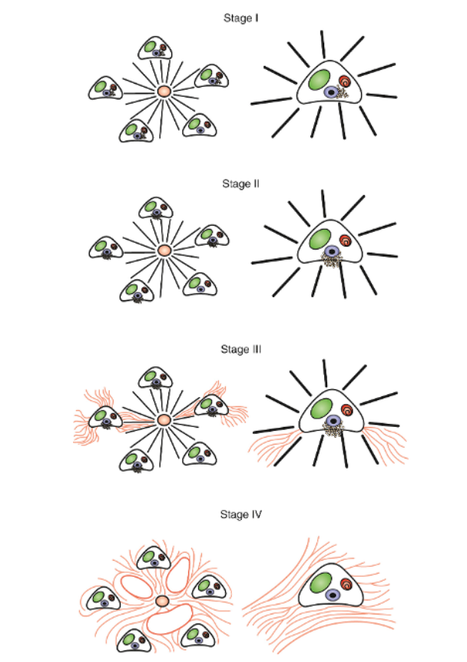
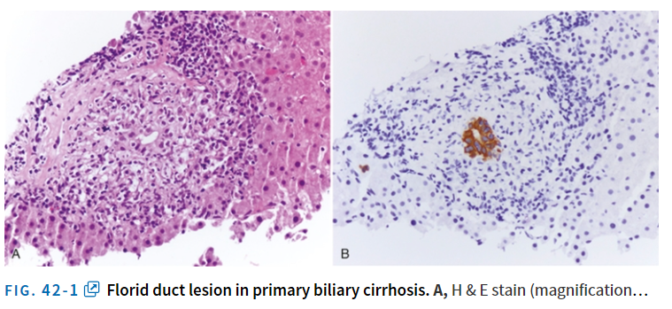
Histology
Non-suppurative granulomatous lymphocytic cholangitis leading on ductopenia and progressive fibrosis.
Staging
Fibrosis
Bile duct loss
Copper associated protein deposits
Liver Biopsy :not necessary for diagnosis
usually done to rule out associated NASH/AIH or if typical antibodies are absent

Slide 35
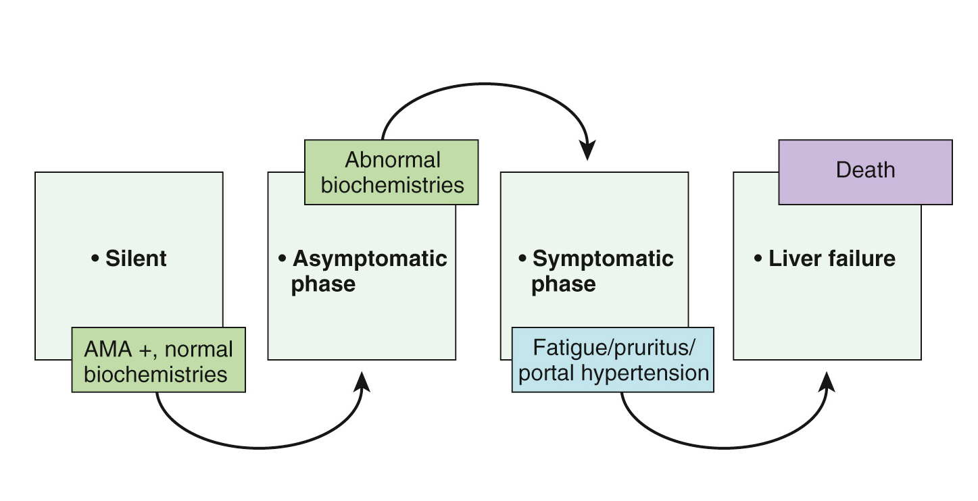
Natural history of Untreated PBC

Slide 36
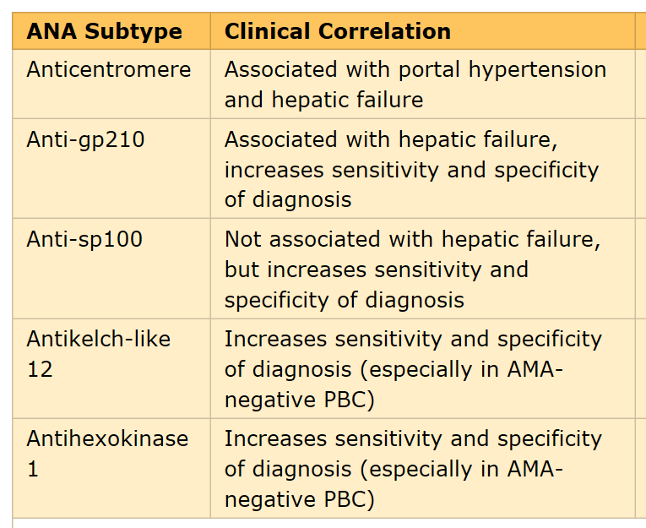
Non invasive markers of Disease stage
Serum markers of fibrosis
Hyaluronic acid
Procollagen III peptide
TIMP 1
APRI
CK-18
M Nakamura Hepatology 2007
Notes:
PBC patients, positive anti-gp210 antibodies was a significant risk factor for hepatic failure type progression [odds ratio (OR) = 33.777, 95% CI: 5.930, 636.745], whereas positive anti-centromere antibodies was a significant risk factor for portal hypertension type progression (OR = 4.202, 95% CI: 1.307, 14.763). Histologically, positive anti-gp210 antibodies was most significantly associated with more severe interface hepatitis and lobular inflammation, whereas positive anticentromere antibodies was most significantly associated with more severe ductular reaction.

Slide 37
Management of PBC

Slide 38
Treatment
UDCA
1-3% of bile acids and becomes the predominant bile acid on pharmacotherapy
Post transcriptional secreatogogue and has anti apoptotic effects on hepatocytes and cholangiocyte
13-15 mg/kg/day
Adverse events-Weight gain, Hair thinning,Diarrhoea and flatulence
No teratogenic effect
Safe in breast feeding
Gastroenterology 2005;129:894–901
J Hepatol 2012;57:133–140.

Slide 39
Treatment
Obeticholic acid (OCA)
Semisynthetic hydrophobic bile acid analogue highly selective for FXR signalling
FXR signaling regulates genes involved in bile acid synthesis,secretion,transport,absorption and detoxification
Has additional anti-inflammatory and metabolic activity
Doses- 10 mg/25 mg/50 mg per day
Side effect-Exacerbation of pruritus, Reversible dyslipidemia.
Williams et al. Gastroenterology 2014

Slide 40

12 mo, double blinded, placebo controlled, RCT
217 patients inadequate response to UDCA/ UDCA side effects (i.e persistent ALP >1.5 ULN)
OCA : 10 mg, 25 mg, 50 mg X 12 month
The primary endpoint of significant reduction in serum ALP from baseline was met across all three doses of OCA vs. placebo.
87%, 69% and 7% of all OCA-treated patients who completed therapy achieved a decline in serum ALP of at least 10%, 20% or complete normalisation (vs. 14%, 8% and 0% with placebo)
Dose dependent increase in pruritic , 1-10 % discontinuation.
EASL 2019: Oral OCA has been conditionally approved for patients with PBC in combination with UDCA for those with an inadequate response to UDCA, or as monotherapy in those intolerant to UDCA.
(initial dose 5 mg; dose titration to 10 mg according to tolerability at six months) (I, 2).
Nevens et al. NEJM 2012

Slide 41
Budesonide
Synthetic corticosteroid with high first pass metabolism in liver
Use of budesonide in patients with florid interface hepatitis: Anecdotal reports
In vitro studies: Biliary protective effect in combination with UDCA Increase AE activity
Phase III trial is ongoing

Slide 42
Fibric acid derivatives
Anti cholestatic effects via activation of PPAR along with down regulation of pathways leading to bile acid synthesis
At high doses inhibit CYP2C9 that control pharmacokinetics of NSAIDS
Side effects- Transaminitis, Musculoskeletal pain
Results from a phase III clinical trial of bezafibrate in PBC are not yet published (NCT01654731).
Hepatology 2015;62:635–643

Slide 43
7 RCTs,
UDCA non responders
A pooled complete biochemical response rate was achieved in 69% of patients
Data from phase III randomised trials for budesonide (in non-cirrhotic patients), and bezafibrate, both in combination with UDCA, are not yet published; EASL suggests currently a recommendation for therapy cannot be
made (II-2, 2).

Slide 44
Inadequate response to treatment
UK-PBC score has shown a better performance of prediction of death or liver transplantation

Slide 45
PBC with features of AIH
Two of the following:
ALP [2 ULN or GGT (5 ULN).
AMA(1:40).
Florid bile duct lesion on histology.
And two of the following three features:
ALT(5 XULN).
IgG serum levels (2 ULN) or smooth muscle autoantibody
Moderate or severe interface hepatitis on histology
Liver biopsy-Mandatory
Hepatology 1998;28:296–301

Slide 46
Known PBC with features of AIH
Patient on UDCA treatment develop features of hepatitis
Liver biopsy mandatory to determine degree of interface hepatitis
Management
Presence of severe/Moderate interface hepatitis mandates immunosuppression
Patients with AIH+PBC or PBC with development of AIH tend to develop less side effect on immunosuppression
They also respond to less intense immunosuppression

Slide 47
Indications of LT in PBC
Decompensated Cirrhosis with complications
PBC Specific
Quality of life
Intractable pruritis
Refractory to medical Rx (cholestyramine, rifampicin, naltrexone etc.)
?Recurrent, debilitating nontraumatic bone fractures
?Recurrent episodes of cholangitis
Fatigue- not reversed with OLT. Try Modafinil
1, 5 and 10-year survival rates in PBC- 80-90%, 77%-88%, and 70-80% respectively
Hasegawa K et al. Transplant International 2005

Slide 48
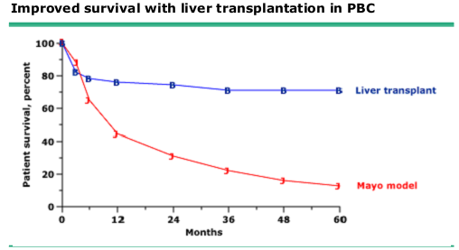
Mayo scores for OLT in PBC
Based on bilirubin, albumin, age, edema, and PT
OLT advised when 6m survival expected to be less than 80% (score ≈ 9.4, bilirubin >10mg/dl))
Christensen E, et al. J Hepatol. 1999

Slide 49
Targeted Management of Extrahepatic Manifestations of PBC and PSC

Slide 50
Management of symptoms
Pruritus
Fatigue
Dyslipidemia
Metabolic Bone Disease

Slide 51
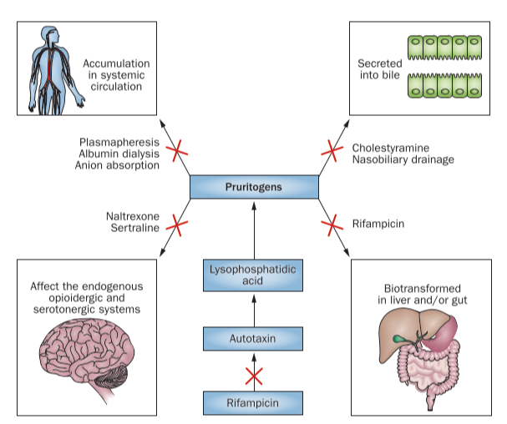
Pruritus

Slide 52
Exclude: Secondary causes of pruritus
Emolients/Cold water bath/psychogenic intervention
Medical treatment
Cholestyramine/Cholesevelam- Bile acid sequestrant
Rifampicin- Pregnane X receptor agonist
Opiate agonists-Naloxone/Naltrexone
SSRI
Physical treatment
NBD
MARS
UV light therapy
Surgery-OLT
EASL Clin practice guidelines Hepatology 2017

Slide 53
Fatigue
Present in over 50% patients
Has both central and peripheral components
Central component-Poor memory and concentration
Not related to UDCA therapy or OLT
Associated conditions including anemia,Hypothyroidism,DM,sleep disorders must be treated
Modafinil
EASL Clin practice guidelines Hepatology 2017

Slide 54
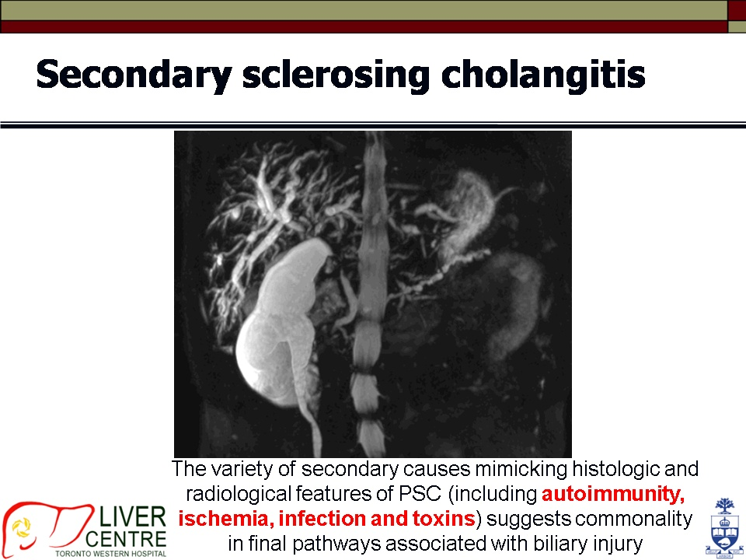

Slide 55
THANK YOU

